Slide 1



BCSC0011 : Theory of Automata & Formal Languages (TAFL)
Class Presentations on Finite Automata for 3rd year Students
By Dr. Sandeep Rathor

Slide 2
What is Automata?
The term "Automata" is derived from the Greek word "αὐτόματα" which means "self-acting“.
It is the plural of automaton, it means “something that works automatically”
A system where energy, materials and information, are transformed for performing some specific task, without direct participation of man.
Example: Automatic photo printing machine, Packing machine, etc.

Slide 3
Model of Discrete Automaton
In Computer Science, Automaton = an abstract computing device which process discrete information.
I1
Automaton
q1,q2,…qn
O1
I2
O2
Ip
Oq
Input: I1, I2,…..Ip
Output: O1,O2,…Oq States: q1,q2,…qn

Slide 4
Why do we need abstract models?
Abstract model is free from “Programming Language”
It’s easy to manipulate these theoretical machines mathematically to prove things about their capabilities.

Slide 5
A simple “computer”
SWITCH
f
BATTERY
start
on
off
f
input: switch
output: light bulb
actions: f for “flip switch”
states: on, off
bulb is on if and only if there was an odd number of flips

Slide 6
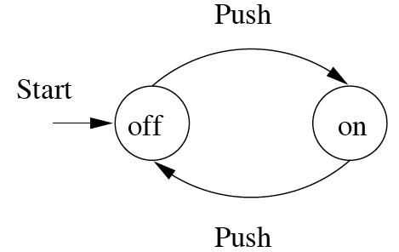
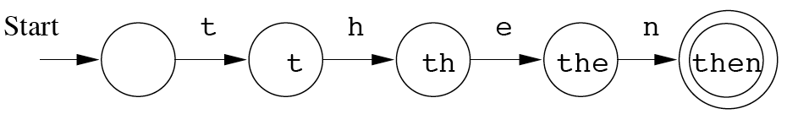
Finite Automata : Examples
On/Off switch
Modeling recognition of the word “then”
action
state
Start state
Transition
Intermediate state
Final state

Slide 7
Transition Diagram
Directed graph consists of set of vertices and edges where vertices represent “states” and edges represent “input/output”
Circle with an arrow is called initial state
Two concentric circle represents the final state

Slide 8
Alphabets
A finite non empty set of symbols.
Symbol : Σ
1. English lang. small letter Σ = {a, b, c … z}
2. Binary number Σ ={0, 1}
3. Decimal number Σ = {0, 1, 2, … , 9}
4. Alphanumeric : Σ = {A-Z, a-z, 0-9}

Slide 9
Strings
A word or a string is a finite sequence of symbols taken from Σ.
Empty string : ϵ
Length of string w is denoted by |w| is number of non empty characters in the string.
Ex. x = 01000 |x| = 5
x = 01ϵ01ϵ00ϵ |x| = ?
xy = concatenation of two string.

Slide 10
Strings
A string over alphabet Σ is a finite sequence of symbols in Σ.
The empty string will be denoted by ε
Examples
abfbz is a string over Σ₁ = {a, b, c, d, …, z}
9021 is a string over Σ₂ = {0, 1, …, 9}
ab#bc is a string over Σ₃ = {a, b, …, z, #}
))()(() is a string over Σ₄ = {(, )}

Slide 11
Languages
L is said to be a language over alphabet Σ only if L ⊆ Σ*.
Σ* Set of all string over the Σ

Slide 12
Deterministic Finite Automata (DFA)
Model Diagram of DFA
Input Tape
a
a
a
b
b
b
Read- Head
Finite Control
*Warren McCulloch and Walter Pitts were among the first researchers to introduce a concept similar to finite automata in 1943.

Slide 13
A deterministic finite automaton (DFA) is a 5-tuple (Q, Σ, δ, q₀, F) where
Q is a finite set of states
Σ is an input alphabet
δ: Q × Σ → Q is a transition function
q₀ ∈ Q is the initial state
F ⊆ Q is a set of accepting states (or final states).
Note: Deterministic refers to the uniqueness of the computation run.

Slide 14
Input Alphabet

Slide 15
Set of States

Slide 16
Initial State

Slide 17
Set of Accepting States or Final State

Slide 18
Transition Function

Slide 22
Transition Function ( ) Contd…

Slide 23
Extended Transition Function

Slide 27
Observation:
Example: There is a walk from to
with label

Slide 28
Example-2
0
1
0,1
q₀
1
q₁
0
q₂
alphabet Σ = {0, 1}
states Q = {q₀, q₁, q₂}
initial state q₀
Final/ accepting states F = {q₀, q₁}
transition function δ:
inputs
0
1
q₀
q₀
q₁
states
q₁
q₂
q₁
q₂
q₂
q₂

Slide 29
Applications
Vending Machine
Traffic lights
Video games
Text parsing
Protocol analysis
Natural language processing

Slide 30
Example of a finite automaton
f
off
on
f
There are states off and on, the automaton starts in off and tries to reach the “good state” on
What sequences of fs lead to the final state?
Answer: {f, fff, fffff, …} = {f ^{n}: n is odd}
This is an example of a deterministic finite automaton over alphabet {f}

Slide 31
Language of a DFA
The language of a DFA (Q, Σ, δ, q₀, F) is the set of all strings over Σ that, starting from q₀ and following the transitions as the string is read left to right, will reach some accepting state.
f
M:
off
on
f
Language of M is {f, fff, fffff, …} = {f ^{n}: n is odd}

Slide 32
Examples
0
0
1
q₀
q₁
1
0
1
1
q₀
q₁
0
0
1
0,1
q₀
1
q₁
0
q₂
What are the languages of these DFAs?

Slide 33
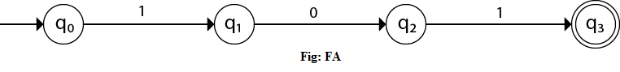
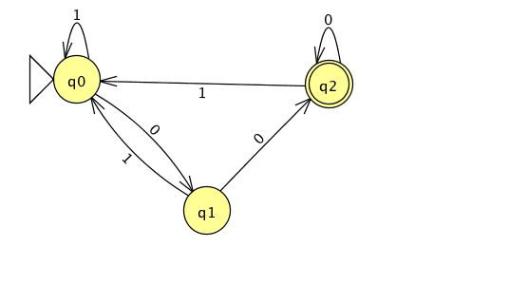
Example: Design a FA with ∑ = {0, 1} accepts the only input 101.
Example: The set of all strings ∑ = {0, 1} ending in 00.

Slide 34
Examples
Construct a DFA that accepts the language
Answer
L = {010, 1}
( Σ = {0, 1} )
q₀
1
q₀₁
0
q₀₁₀
0
0
1
q_{ε}
0, 1
1
q₁
0, 1
q_{die}
0, 1

Slide 35
Σ⁺ and Σ∗
Σ is an alphabet , Σ ={y}
Σ∗ is the set of all strings including null or obtained by concatenating zero or more symbols from Σ
Σ∗={ε, y,yy,yyy,yyyy,…}
Σ⁺ is the set of all strings excluding null or obtained by concatenating one or more symbols
Σ ={y}
Σ⁺ ={y,yy,yyy,yyyy,…}

Slide 36
Example-4: Design a DFA for
= { all strings with prefix }
accept

Slide 37
Example-5: DFA for

Slide 38
Example-6: DFA for
= { all strings without substring }

Slide 39
Ex-7:Design a DFA for language: L = {w | w is a binary string that contains 01 as a substring}

Slide 40
DFA for strings containing 01
Q = {q₀,q₁,q₂}
∑ = {0,1}
start state = q₀
F = {q₂}
Transition table
1
0
0,1
start
0
1
q₀
q₁
q₂
Accepting
state
symbols
0
1
q₀
q₁
q₀
What if the language allows empty strings?
q₁
q₁
q₂
states
*q₂
q₂
q₂

Slide 41
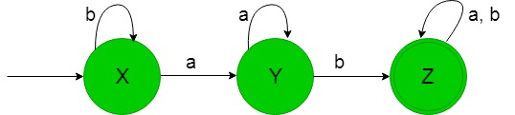
Construction of a DFA accepting set of string over {a, b} where each string containing ‘ab’ as the substring.

Slide 42
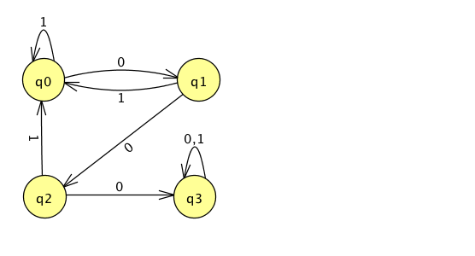
Example: The set of all strings with three consecutive 0's (not necessarily at the end).

Slide 43
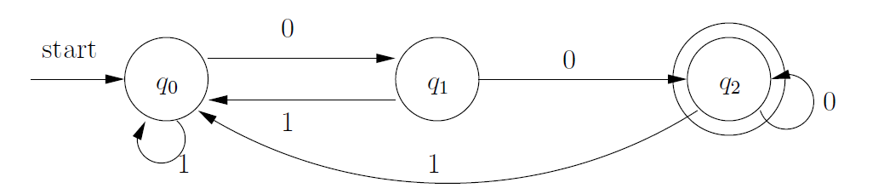
Construct DFA’s accepting the following languages over the alphabet {0, 1}. 1. The set of all strings ending in 00.

Slide 44
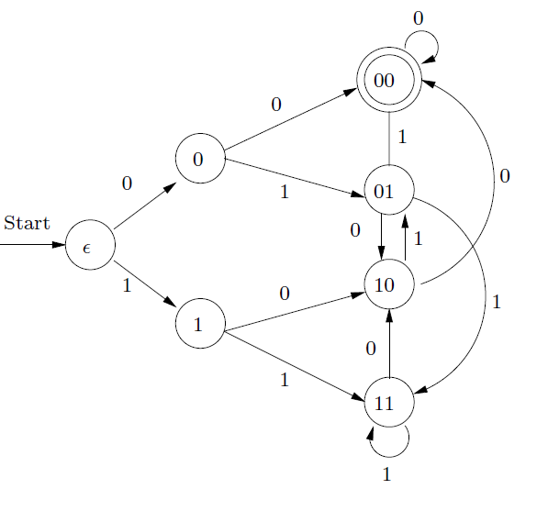
OR The set of all strings ending in 00.

Slide 45
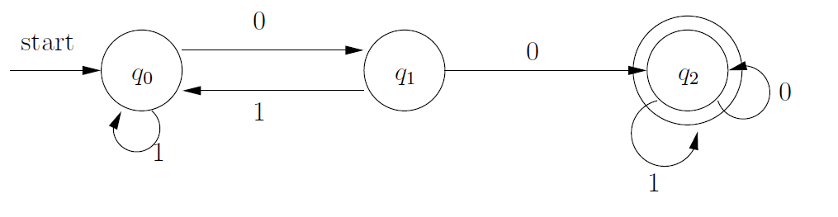
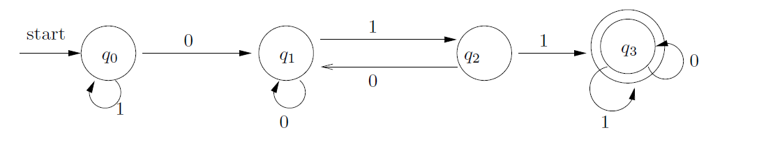
2. The set of all strings with two consecutive 0’s (not necessarily at the end).
3. The set of strings with 011 as a substring

Slide 46
Practice Questions…
DFA for: An Even Number of 1’s
0
0
1
even
odd
Start
1

Slide 47
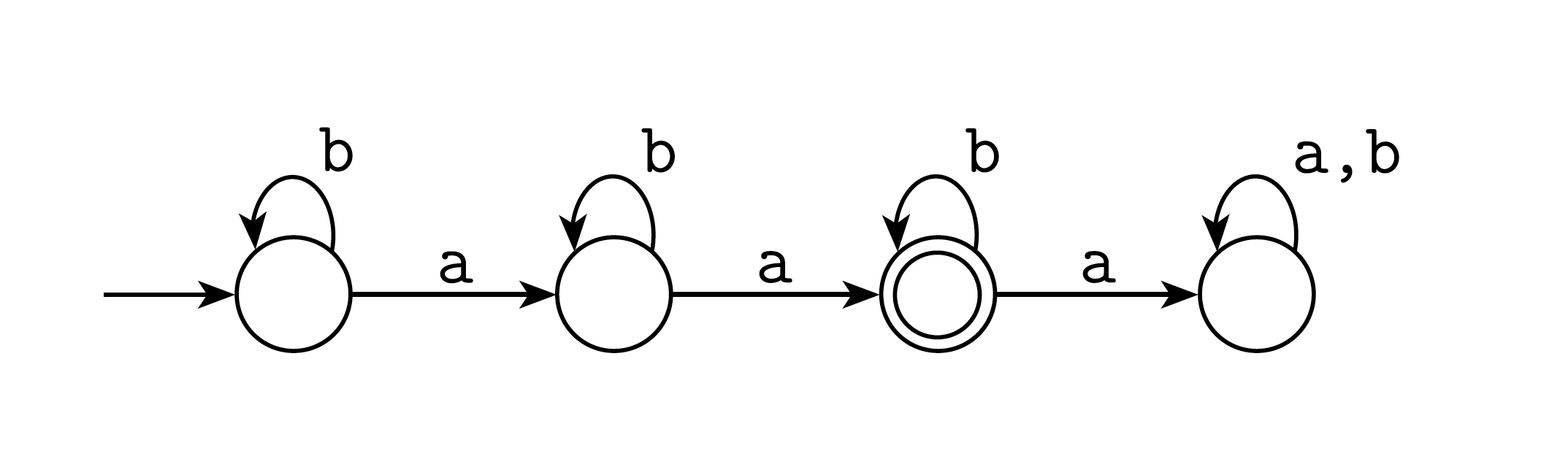
Exactly Two a’s

Slide 48
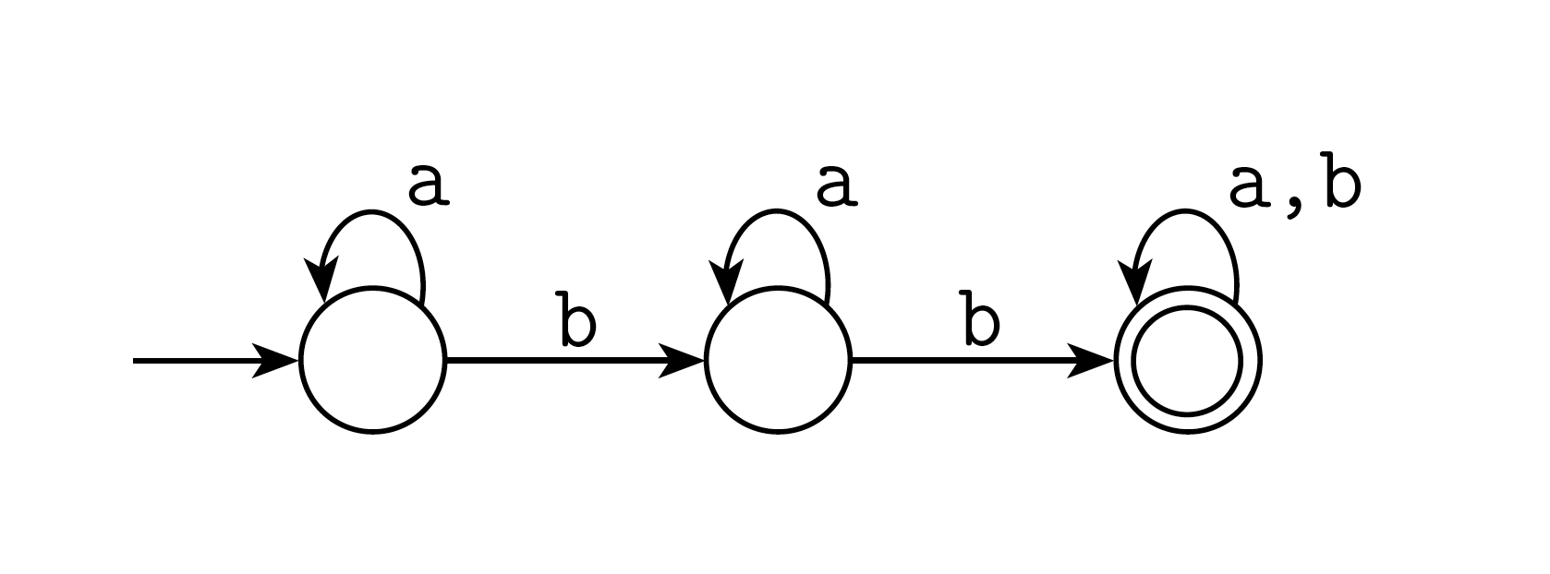
At Least Two b’s

Slide 49
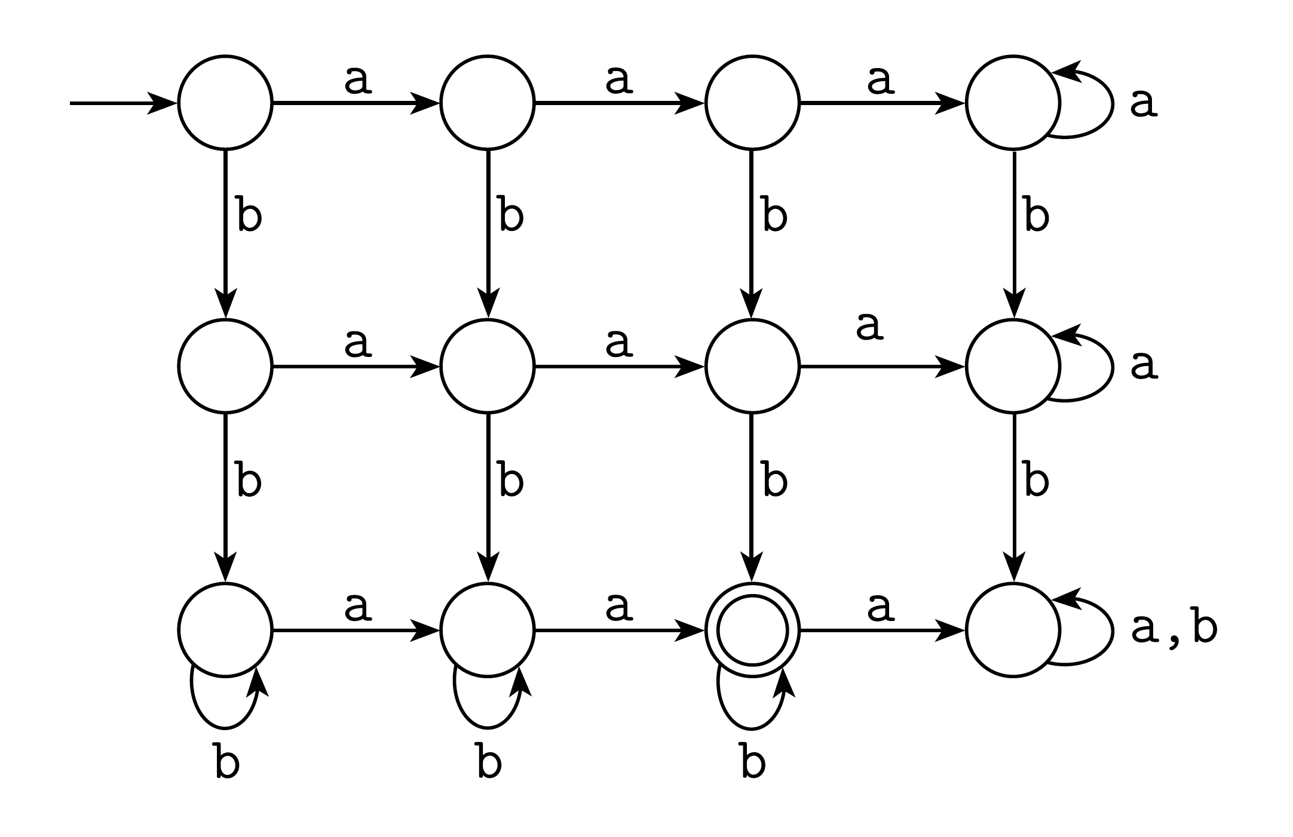
Exactly two a’s and at least two b’s

Slide 50
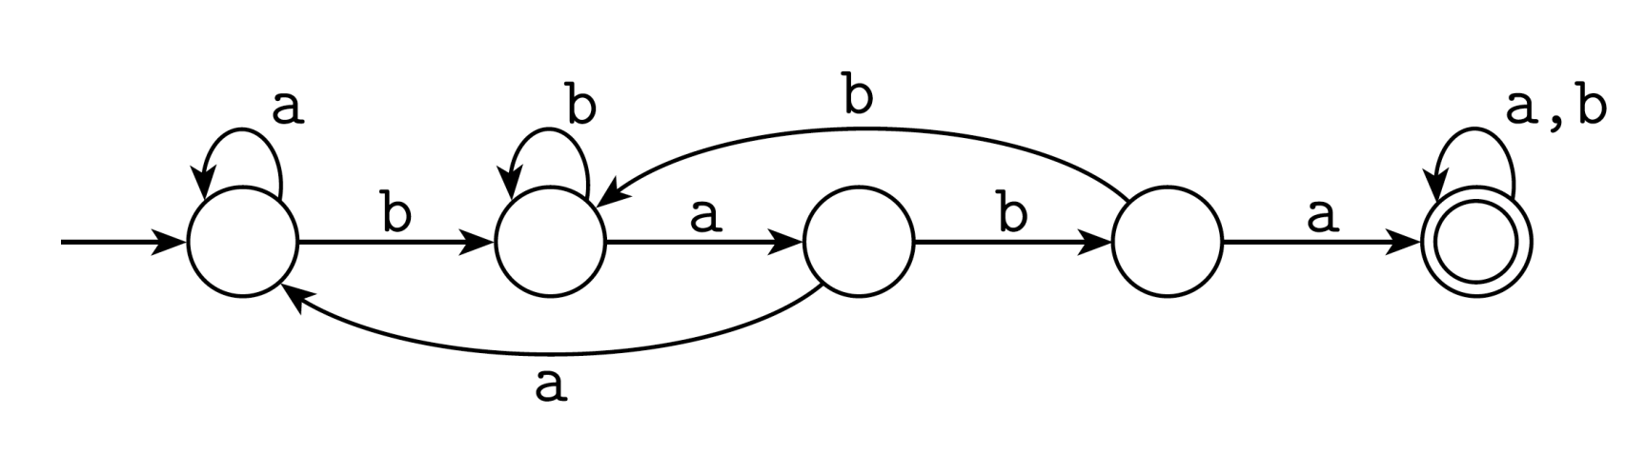
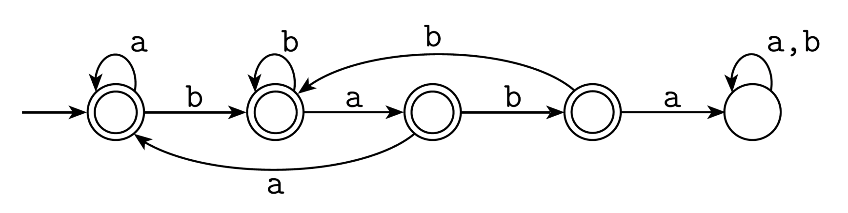
Containing Substrings or Not
Contains baba:
Does not contain baba:

Slide 51
Non-Deterministic Finite Automata (NFA)
A Non-deterministic Finite Automata (NFA) is a 5-tuple
(Q, Σ, δ, q₀, F) where:
Q is a finite set of states
Σ is an input alphabet
δ: is a transition function Q × Σ → 2^{Q} [power set of Q]
q₀ ∈ Q is an initial state
F ⊆ Q is a set of accepting states (or final states).
NFAs were introduced in 1959 by Michael O. Rabin and Dana Scott

Slide 52
Applications of NFA
Chess
Tic Tac Toe
Ludo
Playing Card

Slide 53
Example of DFA & NFA
DFA
NFA/ NDFA
Two choices

Slide 54
First Choice

Slide 55
First Choice

Slide 56
First Choice

Slide 57
First Choice
All input is consumed
“accept”

Slide 58
Second Choice

Slide 59
Second Choice

Slide 60
Second Choice
No transition:
the automaton hangs

Slide 61
Second Choice
Input cannot be consumed
“reject”

Slide 62
Example
is accepted by the NFA:
“accept”
“reject”
because this
computation
accepts

Slide 63
NFA for strings containing 01
Why is this non-deterministic?
Q = {q₀,q₁,q₂}
Σ = {0,1}
start state = q₀
F = {q₂}
Transition table
0,1
0,1
start
0
1
q₀
q₁
q₂
Final
state
symbols
0
1
What will happen if at state q₁ an input of 0 is received?
q₀
{q₀,q₁}
{q₀}
states
q₁
Φ
{q₂}
*q₂
{q₂}
{q₂}

Slide 64
Differences: DFA vs. NFA
DFA
All transitions are deterministic
Each transition leads to exactly one state
For each state, transition on all possible symbols (alphabet) should be defined
Accepts input if the last state visited is in F
Sometimes harder to construct because of the number of states
δ: Q × Σ → Q is a transition function
NFA
Some transitions could be non-deterministic
A transition could lead to a subset of states
Not all symbol transitions need to be defined explicitly (if undefined will go to an error state – this is just a design convenience, not to be confused with “non-determinism”)
Accepts input if one of the last states is in F
Generally easier than a DFA to construct
Q × Σ → 2^{Q} [powerset of Q]

Slide 65
What is an “error state” or dummy state?
A DFA for recognizing the key word “while”
An NFA for the same purpose:
w
h
i
l
e
q₀
q₁
q₂
q₃
q₄
q₅
Any other input symbol
q_{err}
Any symbol
w
h
i
l
e
q₀
q₁
q₂
q₃
q₄
q₅
Transitions into a dead state are implicit

Slide 66
NFA to DFA construction: Example
L = {w | w ends in 01}
1
0
NFA:
DFA:
[q₀]
0
[q₀,q₁]
1
[q₀,q₂]
0,1
0
0
1
1
q₀
q₁
q₂
δ_{D} | 0 | 1
Ø | Ø | Ø
[q₀] | {q₀,q₁} | {q₀}
[q₁] | Ø | {q₂}
*[q₂] | Ø | Ø
[q₀,q₁] | {q₀,q₁} | {q₀,q₂}
*[q₀,q₂] | {q₀,q₁} | {q₀}
*[q₁,q₂] | Ø | {q₂}
*[q₀,q₁,q₂] | {q₀,q₁} | {q₀,q₂}
δ_{D} | 0 | 1
[q₀] | [q₀,q₁] | [q₀]
[q₀,q₁] | [q₀,q₁] | [q₀,q₂]
*[q₀,q₂] | [q₀,q₁] | [q₀]
δ_{N} | 0 | 1
q₀ | {q₀,q₁} | {q₀}
q₁ | Ø | {q₂}
*q₂ | Ø | Ø
0. Enumerate all possible subsets
Determine transitions
2. Retain only those states reachable from {q₀}

Slide 67
NFA to DFA Contd…
L = {w | w ends in 01}
1
0
NFA:
DFA:
[q₀]
0
[q₀,q₁]
1
[q₀,q₂]
0,1
0
0
1
1
q₀
q₁
q₂
δ_{N} | 0 | 1
q₀ | {q₀,q₁} | {q₀}
q₁ | Ø | {q₂}
*q₂ | Ø | Ø
δ_{D} | 0 | 1
[q₀] | [q₀,q₁] | [q₀]
[q₀,q₁] | [q₀,q₁] | [q₀,q₂]
*[q₀,q₂] | [q₀,q₁] | [q₀]
Main Idea:
Introduce states as you go
(on a need basis)

Slide 68
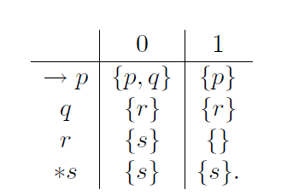
Convert the given NFA to DFA
States | 0 | 1
->[p] | [p,q] | [p]
[p,q] | [p,q,r] | [p,r]
[p,r] | [p,q,s] | [p]
[p,q,r] | [p,q,r,s] | [p,r]
[p,q,s]+ | [p,q,r,s] | [p,r,s]
[p,r,s]+ | [p,q,s] | [p,s]
[p,s]+ | [p,q,s] | [p,s]
[p,q,r,s]+ | [p,q,r,s] | [p,r,s]

Slide 69
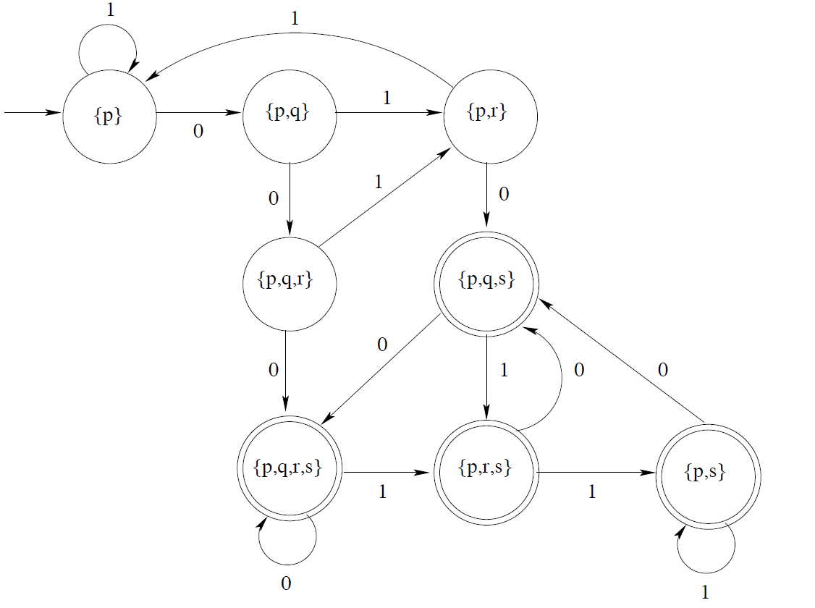
Transition diagram

Slide 70
Practice Session: NFA to DFA

Slide 71
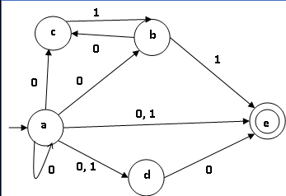
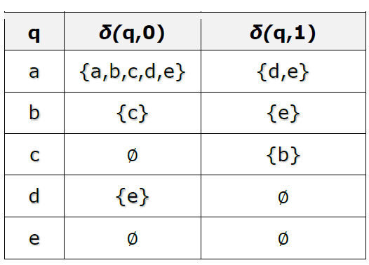
1. Convert NFA to DFA

Slide 72
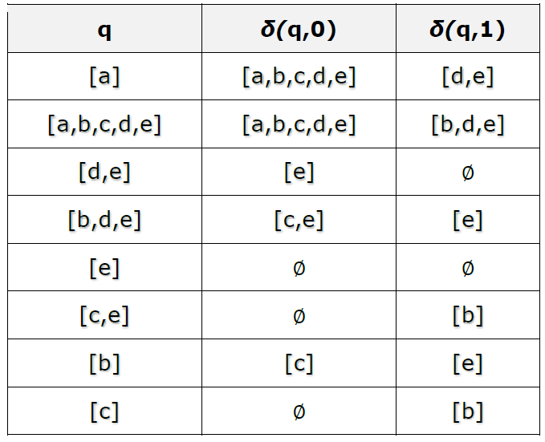
*
*
*
*
*
Required DFA Transition diagram on next page…

Slide 73
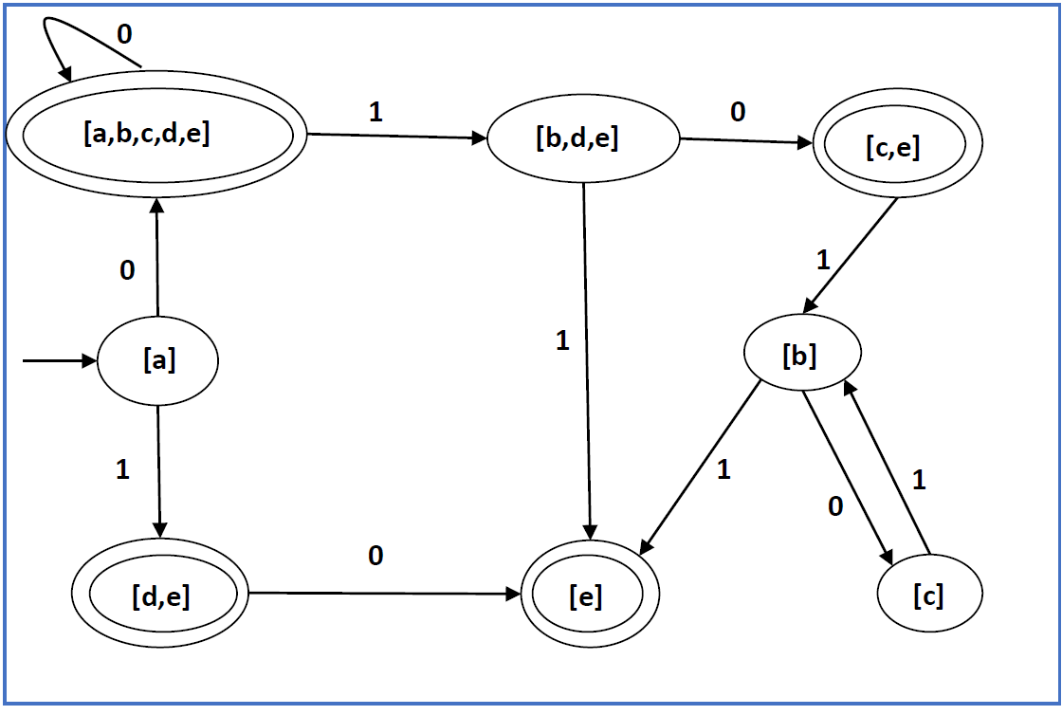

Slide 74
2. Convert into DFA
States | 0 | 1
->p+ | p | q
q | q | p,q
DFA equivalent to given NFA
States | 0 | 1
->[p]+ | [p] | [q]
[q] | [q] | [p,q]
[p,q] + | [p,q] | [p,q]

Slide 75
3. Convert given NFA to DFA
 | 0 | 1
p | q, s | q
*q | r | q, r
r | s | p
*s | - | p

Slide 76
Required DFA
State/ Input | 0 | 1
[p] | [q, s] | [q]
*[q] | [r] | [q, r]
[r] | [s] | [p]
*[s] | φ | [p]
*[q, r] | [r, s] | [p, q, r]
*[q, s] | [r] | [p, q, r]
*[r, s] | [s] | [p]
*[p, q, r] | [q, r, s] | [p, q, r]
*[q, r, s] | [r, s] | [p, q, r]
Transition Diagram…

Slide 77
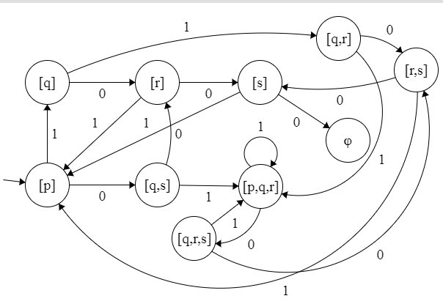

Slide 78
Practice Contd…
4. Convert given NFA to DFA
States/input | 0 | 1
->P+ (Final) | Q, S | Q
Q+ (Final) | R | R,Q
R | S | S
S | - | P

Slide 79
Answer: Required DFA
State/ Input | 0 | 1
[P]+ | [Q,S] | [Q]
[Q]+ | [R] | [R,Q]
[R] | [S] | [S]
[S] | - | [P]
[Q,S] + | [R] | [P,Q,R]
[R,Q] + | [R,S] | [Q,R,S]
[R,S] | [S] | [P,S]
[P,S]+ | [Q,S] | [P,Q]
[P,Q] + | [Q,R,S] | [R,Q]
[P,Q,R] + | [Q,R,S] | [Q,R,S]
[Q,R,S] + | [R,S] | [P,Q,R,S]
[P,Q,R,S] + | [Q,R,S] | [P,Q,R,S]

Slide 80
FA with ε-Transitions
ε -NFAs are those NFAs with at least one explicit ε-transition defined.
Explicit ε-transitions is transition from one state to another state without consuming any additional input symbol

Slide 81
Example of an ε-NFA
L = {w | w is empty, or if non-empty will end in 01}
0,1
ε-closure of a state q, ECLOSE(q), is the set of all states (including itself) that can be reached from q by repeatedly making an arbitrary number of ε-transitions.
q₀
0
q₁
1
q₂
ε
start
q’₀
δ_{E} | 0 | 1 | ε
*q’₀ | Ø | Ø | {q’₀,q₀}
q₀ | {q₀,q₁} | {q₀} | {q₀}
q₁ | Ø | {q₂} | {q₁}
*q₂ | Ø | Ø | {q₂}

Slide 82
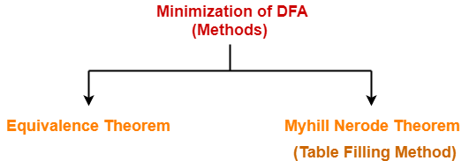
Minimization of DFA

Slide 83
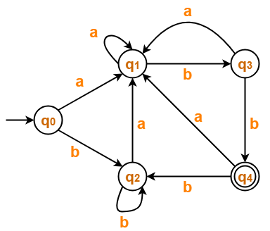
Minimized the given DFA…

Slide 84
Transition table as per given diagram
 | a | b
→q0 | q1 | q2
q1 | q1 | q3
q2 | q1 | q2
q3 | q1 | *q4
*q4 | q1 | q2
Now using Equivalence Theorem, we have-
{ q₀ , q₁ , q₂ , q₃ } { q₄ }
{ q₀ , q₁ , q₂ } { q₃ } { q₄ }
{ q₀ , q₂ } { q₁ } { q₃ } { q₄ }
{ q₀ , q₂ } { q₁ } { q₃ } { q₄ }
Since , so we stop.

Slide 85
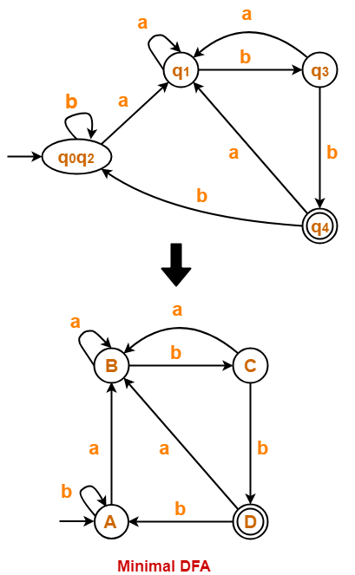
Minimized DFA

Slide 86
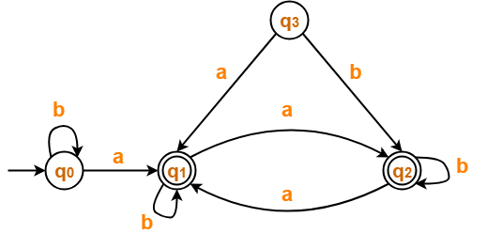
Ex-2, Minimization contd…
 | a | b
→q0 | *q1 | q0
*q1 | *q2 | *q1
*q2 | *q1 | *q2
Transition Table
P₀ = { q₀ } { q₁ , q₂ }
P₁ = { q₀ } { q₁ , q₂ }
Since P₁ = P₀, so we stop.

Slide 87
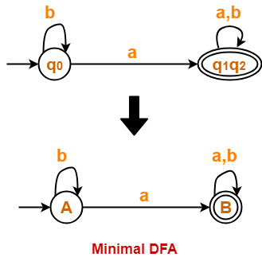
Minimized automata…

Slide 88
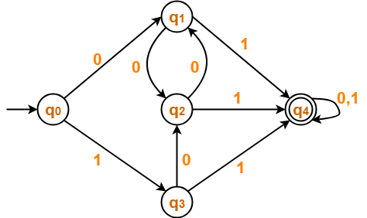
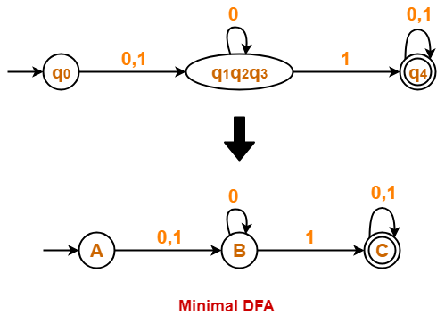
Minimized the following:
Example-3:
Minimized
P₀ = { q₀ , q₁ , q₂ , q₃ } { q₄ }
P₁ = { q₀ } { q₁ , q₂ , q₃ } { q₄ }
P₂ = { q₀ } { q₁ , q₂ , q₃ } { q₄ }

Slide 89
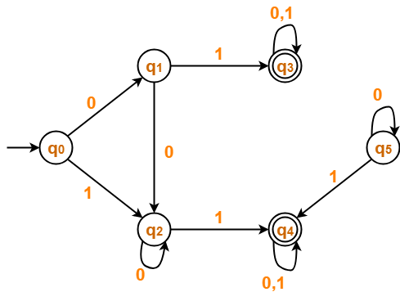
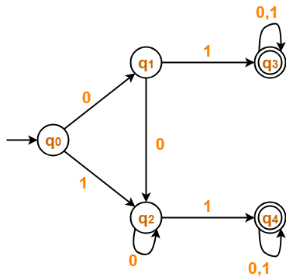
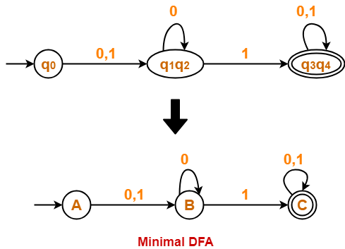
Example-4:
State q₅ is inaccessible from the initial state.
So, we eliminate it and its associated edges from the DFA.
After eliminate q₅ we get
P₀ = { q₀ , q₁ , q₂ } { q₃ , q₄ }
P₁ = { q₀ } { q₁ , q₂ } { q₃ , q₄ }
P₂ = { q₀ } { q₁ , q₂ } { q₃ , q₄ }
Since P₂ = P₁, so we stop.

Slide 90
Example-5 for Practice…
Minimize the given Automata
States/input | 0 | 1
->q₀ | q1 | q5
q1 | q6 | q2
q2+ (Final) | q0 | q2
q3 | q2 | q6
q4 | q7 | q5
q5 | q2 | q6
q6 | q6 | q4
q7 | q6 | q2

Slide 91
Minimizing (Using Equivalence theorem)

Slide 93
Example-6 for Practice…
Minimize the given Automata
States/input | a | b
->q₀ | q1 | q0
q1 | q0 | q2
q2 | q3 | q1
q3+ (Final) | q3 | q0
q4 | q3 | q5
q5 | q6 | q4
q6 | q5 | q6

Slide 94
Minimizing (Using Equivalence theorem)

Slide 96
DFA Minimization using Myhill-Nerode Theorem
Algorithm
Input − DFA
Output − Minimized DFA
Step 1 − Draw a table for all pairs of states (Q_{i}, Q_{j}) not necessarily connected directly [All are unmarked initially]
Step 2 − Consider every state pair (Q_{i}, Q_{j}) in the DFA where Q_{i} ∈ F and Q_{j} ∉ F or vice versa and mark them. [Here F is the set of final states]
Step 3 − Repeat this step until we cannot mark anymore states −
If there is an unmarked pair (Q_{i}, Q_{j}), mark it if the pair {δ (Q_{i}, A), δ (Q_{i}, A)} is marked for some input alphabet.
Step 4 − Combine all the unmarked pair (Q_{i}, Q_{j}) and make them a single state in the reduced DFA.

Slide 97
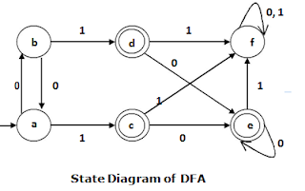
Minimization using Myhill-Nerode Theorem
Step 2 − We mark the state pairs.
Step 1 : We draw a table for all pair of states.
 | a | b | c | d | e | f
a
b
c
d
e
f
 | a | b | c | d | e | f
a
b
c | ✔ | ✔
d | ✔ | ✔
e | ✔ | ✔
f |  |  | ✔ | ✔ | ✔
Step 2 : We mark the state pairs.

Slide 98
Step 3 − We will try to mark the state pairs, with green colored check mark, transitively. If we input 1 to state ‘a’ and ‘f’, it will go to state ‘c’ and ‘f’ respectively. (c, f) is already marked, hence we will mark pair (a, f). Now, we input 1 to state ‘b’ and ‘f’; it will go to state ‘d’ and ‘f’ respectively. (d, f) is already marked, hence we will mark pair (b, f).
 | a | b | c | d | e | f
a
b
c | ✔ | ✔
d | ✔ | ✔
e | ✔ | ✔
f | ✔ | ✔ | ✔ | ✔ | ✔
After step 3, we have got state combinations {a, b} {c, d} {c, e} {d, e} that are unmarked.
We can recombine {c, d} {c, e} {d, e} into {c, d, e}
Hence we got two combined states as − {a, b} and {c, d, e}

Slide 99
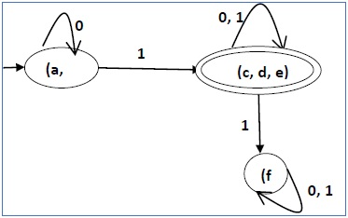
Minimization using Myhill-Nerode Contd…
So the final minimized DFA will contain three states {f}, {a, b} and {c, d, e}
b)

Slide 100
Finite Automata with Output
DFA, NFA, s -NFA are FA without outputs (language acceptors)
Language transducers: Produces output on input
Finite automata may have outputs corresponding to each transition.
There are two types of finite state machines that generate output −
Moore Machine
Mealy Machine

Slide 101
Moore Machine
A Moore machine can be described by a 6 tuple
i.e. (Q, ∑, ∆, δ, λ, q₀) where −
Q is a finite set of states.
∑ is a finite set of symbols called the input alphabet.
∆ is a finite set of symbols called the output alphabet.
δ is the input transition function where δ: Q × ∑ → Q
λ is the output function where λ : Q → ∆
q₀ is the initial state (q₀ ∈ Q).

Slide 102
Example of Moore Machine
bove Moore Machine is −
Present state | Next State |  | Output
 | Input = 0 | Input = 1
→ a | b | c | x₂
b | b | d | x₁
c | c | d | x₂
d | d | d | x₃

Slide 103
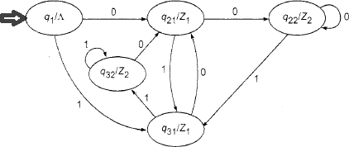
Present State | Next State |  | Output
 | 0 | 1 | ∆
→q0 | q21 | q31 | Λ
q21 | q22 | q31 | Z1
q22 | q22 | q31 | Z2
q31 | q21 | q32 | Z1
q32 | q21 | q32 | Z2

Slide 104
Construction of Moore Machine
Question1: Construct a Moore machine that takes set of all strings {a,b} as input and prints ‘1’ as output for every occurance of ‘ab’ as substring.
Solution: ∑={a,b}
∆= {0,1}
A/0
B/0
C/1

Slide 105
Construction of Moore Machine Contd…
Question2: Construct a Moore machine that takes set of all strings over {a,b} and counts no. of occurrences of substring ‘baa’.
Solution: ∑={a,b}
∆= {0,1}
A/0
B/0
C/0
D/1

Slide 106
Question3: Construct a Moore machine that takes set of all strings over {0,1} and produce ‘A’ as output if input ends with ‘10’ or produces ‘B’ as output if ends with ‘11’ otherwise ‘C’.
Solution: ∑={0,1}
∆= {A,B,C}
1
0
1
1
X/C
Y/C
Z/B
1
0
0
0
W/A

Slide 107
Question4: Construct a Moore machine that takes set of all strings over {0,1} and produce ‘X’ as output if input ends with ‘11’ or produces ‘Y’ as output if ends with ‘10’ otherwise ‘Z’.
Solution: ∑={0,1}
∆= {X,Y,Z}
1
0
1
1
q₀/Z
q₁/Z
q₂/X
1
0
0
0
q₃/Y

Slide 108
Question5: Construct a Moore machine that takes binary numbers as input and produces residue modulo ‘3’ as output.
Solution: ∑={0,1}
∆= {0,1,2}
0
1
1
0
1
q₁/1
0
q₀/0
q₂/2
States | 0 | 1 | ∆
q₀ | q₀ | q₁ | 0
q₁ | q₂ | q₀ | 1
q₂ | q₁ | q₂ | 2

Slide 109
Mealy Machine
A Mealy machine can be described by a 6 tuple
i.e. (Q, ∑, ∆, δ, λ, q₀) where −
Q is a finite set of states.
∑ is a finite set of symbols called the input alphabet.
∆ is a finite set of symbols called the output alphabet.
δ is the input transition function where δ: Q × ∑ → Q
λ is the output function where λ : Q × ∑ → ∆
q₀ is the initial state (q₀ ∈ Q).

Slide 110
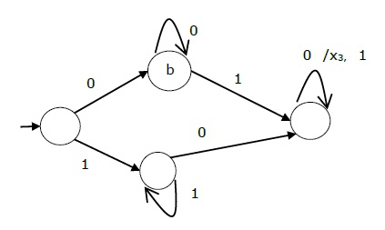
Example of Mealy Machine
Present state | Next state
 | input = 0 |  | input = 1
 | State | Output | State | Output
→ a | b | x₁ | c | x₁
b | b | x₂ | d | x₃
c | d | x₃ | c | x₁
d | d | x₃ | d | x₂
/x2
/x1
/x3
a
/x3
d
/x1
c
/x1

Slide 111
Construction of Mealy Machine
Question1: Construct a mealy machine that takes binary number as input and produces 1’s complement of that number as output. Assume that string is read LSB to MSB.
Solution:
∑={0,1}
∆= {0,1}
0/1
q₀
1/0

Slide 112
Construction of Mealy Machine
Question1: Construct a mealy machine that takes binary number as input and produces 2’s complement of that number as output. Assume that string is read LSB to MSB and end carry is discarded.
Solution: Hint
0/0
MSB LSB
1 1 1 0 1 1 0 0
0 0 0 1 0 0 1 1 1’s
1 2’s
0 0 0 1 0 1 0 0 2’s
1’s Complement
0/1
1/1
q₁
q₀
1/0

Slide 113
Difference b/w Moore & Mealy Machine
Moore Machine | Mealy Machine
Output depends only upon the present state. | Output depends both upon the present state and the present input
Generally, it has more states than Mealy Machine. | Generally, it has fewer states than Moore Machine.
The value of the output function is a function of the current state and the changes at the clock edges, whenever state changes occur. | The value of the output function is a function of the transitions and the changes, when the input logic on the present state is done.
In Moore machines, more logic is required to decode the outputs resulting in more circuit delays. They generally react one clock cycle later. | Mealy machines react faster to inputs. They generally react in the same clock cycle.

Slide 114
Conversion: Moore to Mealy Machine
Algorithm
Input − Moore Machine
Output − Mealy Machine
Step 1 − Take a blank Mealy Machine transition table format.
Step 2 − Copy all the Moore Machine transition states into this table format.
Step 3 − Check the present states and their corresponding outputs in the Moore Machine state table; if for a state Q_{i} output is m, copy it into the output columns of the Mealy Machine state table wherever Q_{i} appears in the next state.

Slide 115
Convert given Moore M/C to Mealy
A/0
B/0
C/1
b/0
a/0
a/0
b/1
A
B
C
a/0
b/0

Slide 116
Convert given Moore M/C to Mealy
Present State | Next State |  | Output
 | a = 0 | a = 1
→ a | d | b | 1
b | a | d | 0
c | c | c | 0
d | b | a | 1
Present State | Next State
 | a = 0 |  | a = 1
 | State | Output | State | Output
=> a | d | 1 | b | 0
b | a | 1 | d | 1
c | c | 0 | c | 0
d | b | 0 | a | 1

Slide 117
Conversion: Mealy Machine to Moore
Algorithm
Input − Mealy Machine
Output − Moore Machine
Step 1 − Calculate the number of different outputs for each state (Q_{i}) that are available in the state table of the Mealy machine.
Step 2 − If all the outputs of Qi are same, copy state Q_{i}. If it has n distinct outputs, break Q_{i} into n states as Q_{in} where n = 0, 1, 2.......
Step 3 − If the output of the initial state is 1, insert a new initial state at the beginning which gives 0 output.

Slide 118
Convert given Mealy M/C to Moore
b/0
a/0
a/0
b/1
A
B
C
a/0
b/0
A/0
B/0
C/1

Slide 119
Convert given Mealy M/C to Moore

Slide 120
Convert given Mealy M/C to Moore (*No. of states may be increased)
Present State | Next State
 | a = 0 |  | a = 1
 | Next State | Output | Next State | Output
→ a | d | 0 | b | 1
b | a | 1 | d | 0
c | c | 1 | c | 0
d | b | 0 | a | 1
Present State | Next State |  | Output
 | a = 0 | a = 1
→ a | d | b₁ | 1
b₀ | a | d | 0
b₁ | a | d | 1
c₀ | c₁ | C₀ | 0
c₁ | c₁ | C₀ | 1
d | b₀ | a | 0

Slide 121
Regular Expression
By: Dr. Sandeep Rathor

Slide 122
Regular Expressions
RE are used for representing certain sets of string in an algebraic form.
It describe the language that is accepted by Finite Automata.
The symbols that appear in RE are letters of alphabets ∑, symbol for null string ε, parenthesis, star operator and plus sign.

Slide 123
A Regular Expression can be recursively defined as:
ε is a Regular Expression indicates the language containing an empty string. (L (ε) = {ε})
φ is a Regular Expression denoting an empty language. (L (φ) = { })

Slide 124
Regular expressions: Rule
Union of two RE, R1and R2, written as R1+R2, is also a RE.
Concatenation of two RE, R1and R2, written as R1R2, is also a RE.
Iteration of RE, R written as R*, is also a RE.

Slide 125
RE Examples
Regular Expressions | Regular Set
(0 + 10*)
L = { 0, 1, 10, 100, 1000, 10000, … }
(0*10*)
L = {1, 01, 10, 010, 0010, …}
(0 + ε)(1 + ε)
L = {ε, 0, 1, 01}
Set of strings of a’s and b’s of any length including the null string. So L = { ε, a, b, aa , ab , bb , ba, aaa…….}
(a+b)*
Set of strings of a’s and b’s ending with the string abb. So L = {abb, aabb, babb, aaabb, ababb, …………..}
(a+b)*abb
(11)*
Set consisting of even number of 1’s including empty string, So L= {ε, 11, 1111, 111111, ……….}
Set of strings consisting of even number of a’s followed by odd number of b’s , so L = {b, aab, aabbb, aabbbbb, aaaab, aaaabbb, …………..}
(aa)*(bb)*b
(aa + ab + ba + bb)*
String of a’s and b’s of even length can be obtained by concatenating any combination of the strings aa, ab, ba and bb including null, so L = {aa, ab, ba, bb, aaab, aaba, …………..}

Slide 126
Represent these sets by RE
{ε, 0, 00, 000, 0000,…}
{ε, ab}
{01,10}
{ε ,10,01}
Ans: 0*
Ans: ε+ ab
Ans: 01+10
Ans: ε+ 10+01
Set of all strings ending in b.
Set of all strings staring with a and ending with ba
Ans: (a+b)*b
Ans: a(a+b)*ba

Slide 127
(a) The set of all strings over {0, 1} with three consecutive 0's.
(b) The set of all strings over {0, 1} beginning with 00.
(c) The set of all strings over {0. 1} ending with 00 and beginning with 1.
(d)all the string containing exactly two 0’s.
(e)
(0+1)*000(0+1)*
00(0+1)*
1(0+1)*00
1*01*01*

Slide 128
All strings containing an even number of 0's:
1* + (1*01*0)*1*
All strings having at least two occurences of the substring 00:
(1 + 0)* 00(1 + 0)* 00(1 + 0)* + (1 + 0)* 000(1 + 0)*
Find a regular expression corresponding to the language of strings of even lengths over the alphabet of { a, b }. ( aa + ab + ba + bb )*

Slide 129
Find a regular expression corresponding to the language of all strings over the alphabet { a, b } that do not end with ab.
( a + b )*( a + bb )
Find a regular expression corresponding to the language of all strings over the alphabet { a, b } that contain exactly two a's.
b*a b*a b*

Slide 130
Identities Related to Regular Expressions
Given R, P, L, Q as regular expressions, the following identities hold
∅* = ε
ε* = ε
RR* = R*R
R*R* = R*
(R*)* = R*
(PQ)*P =P(QP)*
(a+b)* = (a*b*)* = (a*+b*)* = (a+b*)* = a*(ba*)*
R + ∅ = ∅ + R = R (The identity for union)
R ε = ε R = R (The identity for concatenation)
∅ L = L ∅ = ∅ (The annihilator for concatenation)
R + R = R (Idempotent law)
L (M + N) = LM + LN (Left distributive law)
(M + N) L = ML + NL (Right distributive law)
ε + RR* = ε + R*R = R*

Slide 131
Arden's Theorem

Slide 132
Arden’s Theorem
Statement: Let P and Q are two regular expressions over Σ and if P does not contain ε , then the following equation in R, has a unique solution given by
Application: The Arden's Theorem is useful to solve a regular expression.
R = Q + RP
R = QP*

Slide 133
Proof
Part I: Prove that R = QP* is the solution of this equation
R = Q + RP
Replace R by QP* on both sides
LHS = QP*
RHS = Q + QP*P
= Q (ε + P*P)
= QP* // (As we know that ε + A*A = A*)
=LHS
Thus, R = QP* is the solution of the equation R = Q + RP.

Slide 134
Part II : Prove that this is the only solution of this equation.
R = Q + RP
Replace R by Q + RP on RHS
R = Q + (Q + RP) P
= Q + QP + RP²
Keep replacing R by Q + RP
R = Q + QP + (Q + RP) P²
= Q + QP + QP² + RP³
…
= Q + QP + QP² + QP³ + … + QP^{i} + RP^{i+1}

Slide 135
R = Q + QP + QP² + QP³ + … + QP^{i} + RP^{i+1}
= Q (ε + P + P² + … + P^{i}) + RP^{i+1} for i ≥ 0
We claim that any soln of R = Q + RP must be equivalent to QP*
Let w ∈ R and |w| = i.
then w belongs to set Q (ε + P + P² + … + P^{i}) + RP^{i+1} ,
as P does not contain null. RP^{i+1} has no string of length less i+1 so,
w is not in set RP^{i+1}
It means w belongs to the set Q (ε + P + P² + … + P^{i})
and hence it is equivalent to QP*

Slide 136
Arden's Theorem DFA to RE

Slide 137
Assumptions for Applying Arden’s Theorem
The transition diagram must not have NULL transitions
It must have only one initial state

Slide 138
Find Regular Expression of the given DFA?
Using Arden’s Theorem

Slide 139
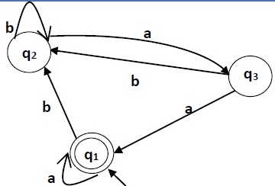
Find the RE
Step 1: Construct the equations
q₁ = q₁a + q₃a + ε
q₂ = q₁b + q₂b + q₃b
q₃ = q₂a
Step 2: Solve the equations
(a + b(b + ab)*aa)*

Slide 140
q₁ = q₁a + q₃a + ε
q₂ = q₁b + q₂b + q₃b
q₃ = q₂a
Now, we will solve these three equations −
q₂ = q₁b + q₂b + q₃b
= q₁b + q₂b + (q₂a)b (Substituting value of q₃)
= q₁b + q₂(b + ab)
= q₁b (b + ab)* (Applying Arden’s Theorem)
q₁ = q₁a + q₃a + ε
= q₁a + q₂aa + ε (Substituting value of q₃)
= q₁a + q₁b(b + ab*)aa + ε (Substituting value of q₂)
= q₁(a + b(b + ab)*aa) + ε
= ε (a+ b(b + ab)*aa)*
= (a + b(b + ab)*aa)*
Hence, the regular expression is (a + b(b + ab)*aa)*.

Slide 141
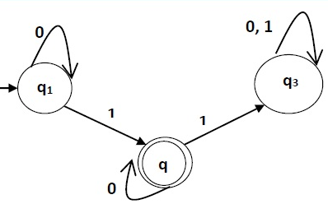
Find the RE
Step 1: Construct the equations
q₁ = q₁0 + ε
q₂ = q₁1 + q₂0
q₃ = q₂1 + q₃ (0 + 1)
Step 2: Solve the equations
0*10*

Slide 142
Solution −
Here the initial state is q₁ and the final state is q₂
Now we write down the equations −
q₁ = q₁0 + ε
q₂ = q₁1 + q₂0
q₃ = q₂1 + q₃0 + q₃1
Now, we will solve these three equations −
q₁ = ε0* [As, εR = R]
So, q₁ = 0*
q₂ = 0*1 + q₂0
So, q₂ = 0*1(0)* [By Arden’s theorem]
Hence, the regular expression is 0*10*.

Slide 143
For Practice
ql = q₁a + q₂b +ε
q2 = q₁ a + q₂b + q₃ a
q3 = q₂a
q2 = q₁ a + q₂ b + q2aa
= q₁ a + q2(b + aa)
= q₁ a(b + aa)*
q₁ = q₁ a + q₁ a(b + aa)*b + ε
= q₁(a + a(b + aa)*b) + ε
q₁ = ε(a + a(b + aa)*b)*
q2 = (a + a(b + aa)*b)* a(b + aa)*
q3 = (a + a(b + aa)*b)* a(b + aa)*a
Q3 is the final state. So RE
(a + a(b + aa)*b)*a(b + aa)*a

Slide 144
a

Slide 146
Using Arden’s theorem

Slide 147
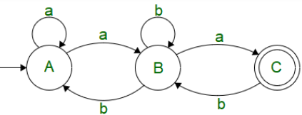
Find the RE
Step 1: Construct the equations
A = Aa + Bb + ε
B = Aa + Bb + Cb
C = Ba
Step 2: Solve the equations
(a + a(b + ab)*b)* a (b + ab)* a

Slide 148
Elimination of Null Moves
Step 1 Find all the edges starting from V2.
Step 2 Duplicate all these edges starting from V1 without changing the edge labels.
Step 3 If V1is an initial state, make V2 also as initial state.
Step 4 If V2 is a final state. make V1 also as the final state.
^
V1
V2

Slide 151
RE to DFA
(0 + 1)*(00 + 11)(0 + 1)*

Slide 153
DFA corresponding to given RE

Slide 154
Find DFA from given RE
10 + (0 + 11)0*1
q0
qf

Slide 155
Final DFA as per the given RE

Slide 156
Find DFA of a*(ba*)*

Slide 157
Pumping lemma for Regular Sets
Statement:
Let M = (Q, Σ, δ, q₀, F) be a finite automaton with n states. Let L be the regular set accepted by M. Let w ∈ L and |w|≥ m. If m ≥n, then there exists x, y, z such that w=xyz, y≠ ^, and xy^{i}z ∈ L for each i ≥0.
*Pumping Repeating a section of the string an arbitrary number of times (≥0), with the resulting string remaining in the language.

Slide 158
OR
If L is a Regular Language, then there is a number p (the pumping length) where if w is any string in L of length at least p, then w may be divided into 3 pieces, w= xyz, satisfying the following conditions:
a. For each i ≥ 0, xy^{i}z ∈ L,
b. |y| > 0, and
c. |xy| ≤ p.

Slide 159
Proof:
Let w=a1,a2,…..am, m≥n
δ(q0,a1,a2,a3….ai)=qi for i=1,2,3,…..,m
Q={q0,q1, q2, ….. qm}
Q is the sequence of states in the path with path value w=a1,a2,a3….am. As there are only n distinct states, at least two states in Q must concide. Among various pair of repeated states, we take the first pair. Let take them as qj and qk(qj= qk). J and k satisfy the condition 0≤j<k≤n.

Slide 160
String w can be decomposed into 3-substrings,
x=a1,a2,……….aj
Y=aj+1………...ak
Z= ak+1…………………… am
The path with the path value w in the transition diagram of M is shown as:
Automaton M starts from the initial state qQ. On applying the string
x, it reaches qj(=qk). On applying the string y, it comes back to qj(= qk) So, after application of y' for each i ≥ 0, the automaton is in the same state qj. On applying z, it reaches qm, a final state. Hence, xy'z ∈ L. As every state in Q is obtained by applying an input symbol, y ≠ A (null).

Slide 161
Let M = (Q, Σ, c, q1 , F) be a DFA recognizing L and p be the number of states of M. Let w = s 1 s2 ...sn be a string in L with length n, where n ≥ p. Let r1,...,rn + 1 be the sequence of states M enters when processing s. ri+1 = δ(ri , si ) for 1 ≤ i ≤ n. The sequence has length n+1, which is at least p + 1.
Among the first p + 1 elements in the sequence, two must be the same state, via the pigeonhole principle. The first is called rj , and the second is rl . Because rl occurs among the first p + 1 places in a sequence starting at r1 , we have l ≤ p + 1.

Slide 162
Now let x = s 1 ...s j-1, y = sj ...sl-1, and z = sl ...sn . As x takes M from r1 to rj , y takes M from rj to rl , and z takes M from rl to rn+1, which is an accept state, M must accept xy^{i}z for i ≥ 0.
We know j ≠ l, so |y| > 0; and l ≤ p + 1, so |xy| ≤ p.
Thus, we have satisfied all conditions of the pumping lemma.

Slide 163
B = {0 n 1 n | n ≥ 0} Is this Language a Regular Language?
Assume B is Regular, then Pumping Lemma must hold. p is the pumping length given by the PL.
Choose s to be 0^{p}1^{p}. Because s ∈ B and |s| ≥ p, PL guarantees s can be split into 3 pieces, s = xyz, where for any i ≥ 0, xy^{i}z ∈ B. Consider 3 cases:
1. y is only 0s. xyyz has more 0s than 1s, thus a contradiction via condition 1 of PL.
2. y is only 1s. Also a contradiction.
3. y is both 0s and 1s. xyyz may have same number of 1s and 0s, but will be out of order, with some 1s before 0s, also a contradiction. Contradiction is unavoidable, thus B is not Regular.

Slide 164
Prove that the language {a^{k}b^{k} | k ≥ 0} is not regular.

Slide 165
Prove that L = {a^{i}b^{i} | i ≥ 0} is not regular.
Solution −
At first, we assume that L is regular and n is the number of states.
Let w = a^{n}b^{n}. Thus |w| = 2n ≥ n.
By pumping lemma, let w = xyz, where |xy| ≤ n.
Let x = a^{p}, y = a^{q}, and z = a^{r}b^{n}, where p + q + r = n, p ≠ 0, q ≠ 0, r ≠ 0. Thus |y| ≠ 0.
Let k = 2. Then xy²z = a^{p}a^{2q}a^{r}b^{n}.
Number of as = (p + 2q + r) = (p + q + r) + q = n + q
Hence, xy²z = a^{n+q} b^{n}. Since q ≠ 0, xy²z is not of the form a^{n}b^{n}.
Thus, xy²z is not in L. Hence L is not regular.

Slide 166
Closure Property of Regular Set
Union,
Concatenation
Closure (iteration)
Transpose
Intersection
Complementation.
Class of regular sets is closed under union, concatenation and closure.

Slide 167
Questions for practice on RE
1. find regular expression L ∈{a,b}*
Set of all strings ending in b: (a+b)* b
Set of all strings ending in ba: (a+b)*ba
Set of all strings ending neither in b nor in ba: (a+b)*aa+a+ ε
Set of all strings ending neither in ab nor ba: ε+a+b+(a+b)*(aa+bb)
2.

Slide 168
TAFL-Course Outcomes
CO1 | Understand and interpret Context Free languages, Expression and Grammars. | U
CO2 | Understand the limitations of each model of computation. | U
CO3 | Apply model of computation to different problems. | Ap
CO4 | Develop analytical thinking and intuition for problem solving situations in related areas of theory of computation. | Ap
CO5 | Understand the limitations of computation, i.e. the insolvability of problems. | U, Ap
CO6 | Compare, understand and analyze different languages, grammars, Automata and Machines. | U, Analyze
CO7 | convert grammar/regular expression into respective automata and vice-versa. | Ap

Slide 169
TAFL- Credits: 4:0:0
 | Course Outcome | POs/ PSOs | Cognitive Level | KC | Class Sessions
CO1 | Understand and interpret Context Free languages, Expression and Grammars. | PO1, PO10, PSO1 | U | F, C | 3
CO2 | Understand the limitations of each model of computation. | PO1, PO10, PSO1 | U | C | 9
CO3 | Apply model of computation to different problems. | PO1, PSO1 | Ap | C, P | 4
CO4 | Develop analytical thinking and intuition for problem solving situations in related areas of theory of computation. | PO3, PO4, PO5, PSO1 | Ap | C, P, MC | 10
CO5 | Understand the limitations of computation, i.e. the insolvability of problems. | PO3, PO4, PO5, PSO1 | U, Ap | C, P | 8
CO6 | Compare, understand and analyze different languages, grammars, Automata and Machines. | PO3, PO4, PO5, PSO1 | U, Analyze | C, P, C&S | 6
Total Hours of instruction |  |  |  |  | 40

Slide 170
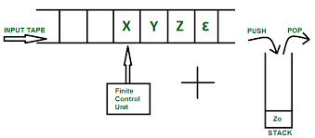
PDA (Push Down Automata)

Slide 171
A pushdown automaton (PDA) consists of seven-tuple:
M = (Q, Σ, Г, δ, q₀, z₀, F)
Q A finite set of states
Σ A finite input alphabet
Г A finite stack alphabet
q₀ The initial/starting state, q₀ is in Q
z₀ A starting stack symbol,
F A set of final/accepting states, which is a subset of
δ A transition function, where
δ: Q x (Σ U {ε}) x Г –> Q x Г*
δ: Q x (Σ U {ε}) x Г –> 2^{Q x Г*} (case of NPDA)

Slide 172
Model of PDA
Input String
R-Head
Stack
Finite Control
R/W -Head
top

Slide 173
The States
Input
symbol
Pop
symbol
Push
symbol

Slide 174
State Representation & Execution

Slide 175
input
stack
top
Replace

Slide 176
input
stack
top
Push

Slide 177
input
stack
top
Pop

Slide 178
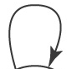
PDA for L={a^{n}b^{n}: n ≥ 1}
δ(q₀, a, Z₀) = (q₀, aZ₀)
δ(q₀, a, a) = (q₀, aa)
δ(q₀, b, a) = (q₁, ε)
δ(q₁, b, a) = (q₁, ε)
δ(q₁, ε, Z₀) = (q_{f}, Z₀) // By Final State
OR
δ(q₁, ε, Z₀) = (q₁, ε)// by empty stack

Slide 179
PDA for L={a^{n}b^{2n}: n ≥ 1}

Slide 180
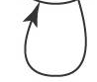
PDA for L={w / n_{a}(w) = n_{b}(w)}

Slide 181
PDA for L={a^{n}b^{n}c^{m} :n,m ≥ 1}

Slide 182
PDA for L={a^{n}b^{m}c^{n} :n,m ≥ 1}

Slide 183
PDA for L={wcw^{R} : wϵ(a,b)⁺}

Slide 184
PDA for L={ww^{R} :wϵ(a,b)⁺}

Slide 185
PDA for L={a^{m+n}b^{m}c^{n} :n,m ≥ 1}

Slide 186
PDA for L={a^{2n}b^{n}: n ≥ 1}

Slide 187
Applications of PDA
Online Transaction process system
Tower of Hanoi (Recursive Solution)
Timed Automata Model
Deterministic Top Down Parsing LL Grammar
Context free Language
Predictive Bottom up Parsing LR Grammar
For implementation of stack applications.
For evaluating the arithmetic expressions.
Applications of TM
For solving any recursively enumerable problem.
For understanding complexity theory.
For implementation of neural networks.
For implementation of Robotics Applications.
For implementation of artificial intelligence.

Slide 188
Q & A
Give a CFG for language L={xє{0,1}* / x start and ends with different symbol}
2. Which of these not in GNF:
3. Prove that following grammar is ambiguous

Slide 189
4. Convert following grammar into CNF:
5. Convert following grammar to PDA:
6. Eliminate Null and Unit production:

Slide 190
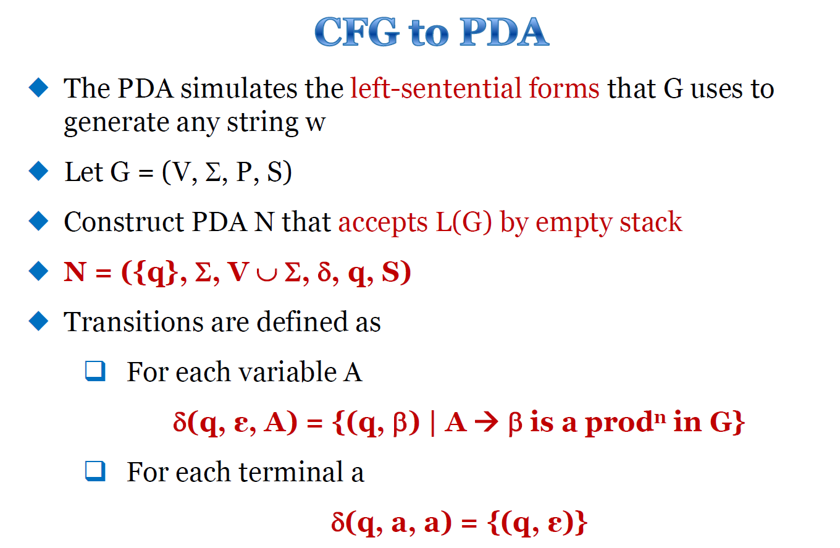

Slide 191
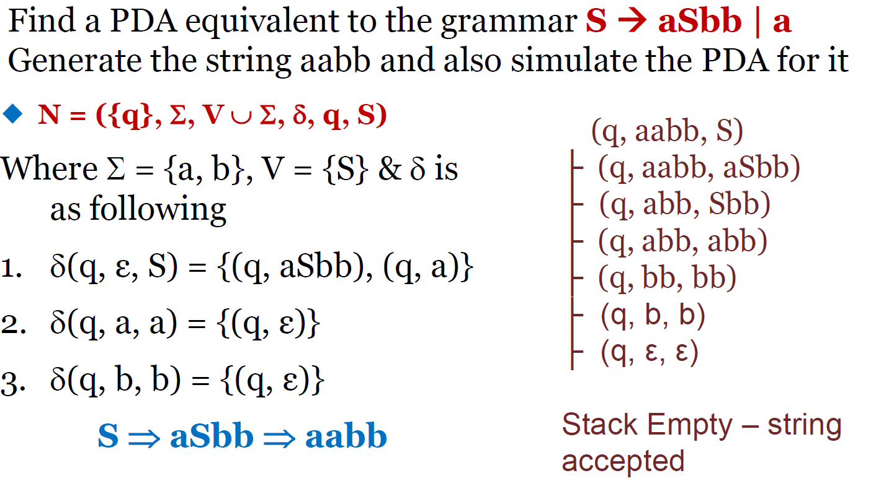

Slide 192
Construction of PDA by a CFG
δ(q, ε, A) = {(q, α)/ A-> α in P}
δ(q, t, t) = {(q, ε)} for every t in Σ
Construct PDA equivalent to following CFG:
S->0/1/1A
A->0/1S
Ans:
δ(q, ε,S) = {(q, 0), (q, 1), (q, 1A)}
δ(q, ε, A) = {(q, 0), (q, 1S)}
δ(q, 0, 0) = {(q, ε)}
δ(q, 1, 1) = {(q, ε)}
2. Convert following CFG to PDA
S->aAA
A->aS/bS/a

Slide 193
Find a PDA equivalent to the following grammar that
generates simple expressions like a * (a + b010)
E → I | E * E | E + E | (E)
I → a | b | Ia| Ib | I0 | I1
Let N be a PDA that accepts the language generated
by the given CFG
N = ({q}, ∑, V U ∑, δ, q, S)
∑ = {a, b, 0, 1, (, ), *, +}
V = {E, I)

Slide 194
1. δ(q, ε, E) = {(q, I), (q, E*E), (q, E+E), (q,(E))}
2. δ(q, ε, I) = {(q, a), (q, b), (q, Ia), (q, Ib), (q, I0), (q, I1)}
3. δ(q, a, a) = {(q, ε)}
4. δ(q, b, b) = {(q, ε)}
5. δ(q, 0, 0) = {(q, ε)}
6. δ(q, 1, 1) = {(q, ε)}
7. δ(q, (, () = {(q, ε)}
8. δ(q, ), )) = {(q, ε)}
9. δ(q, *, *) = {(q, ε)}
10. δ(q, +, +) = {(q, ε)}

Slide 195
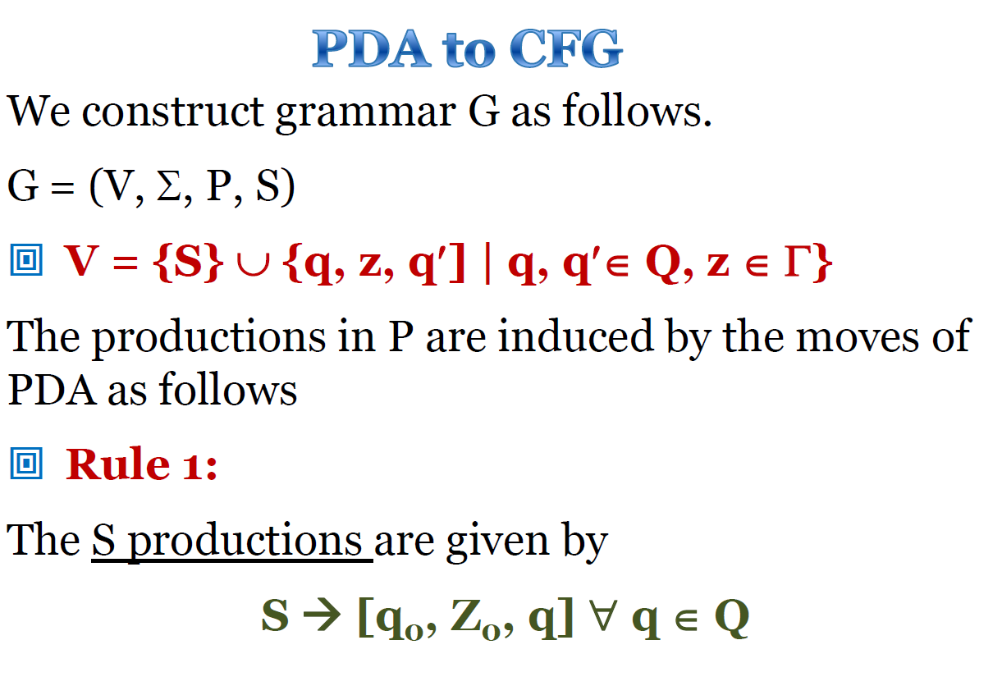

Slide 196
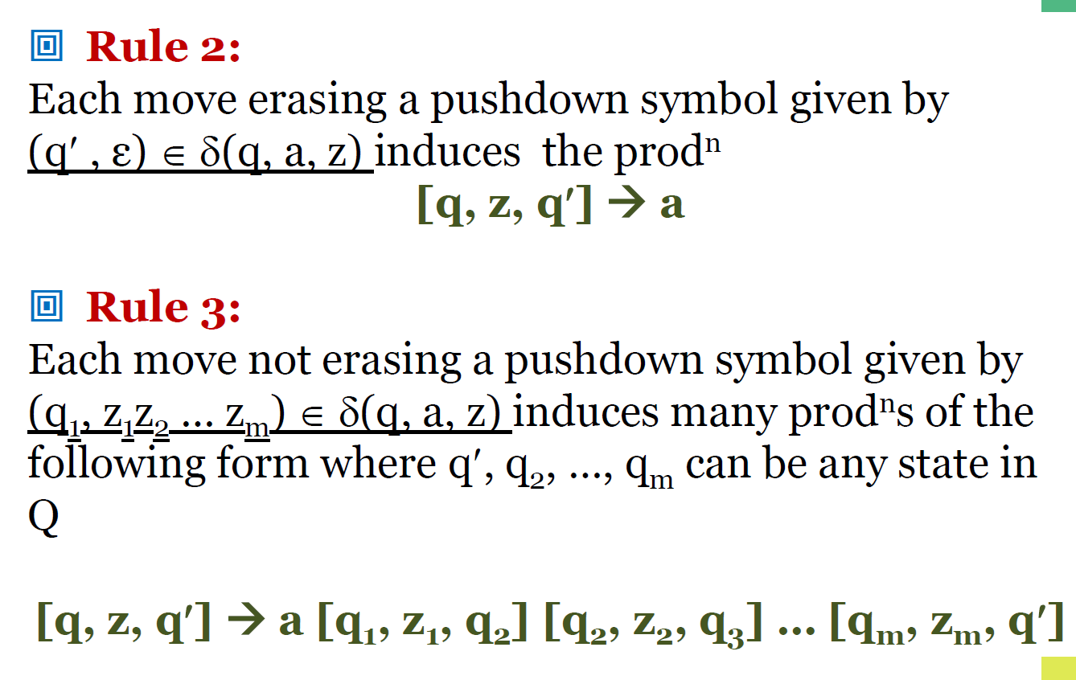

Slide 197
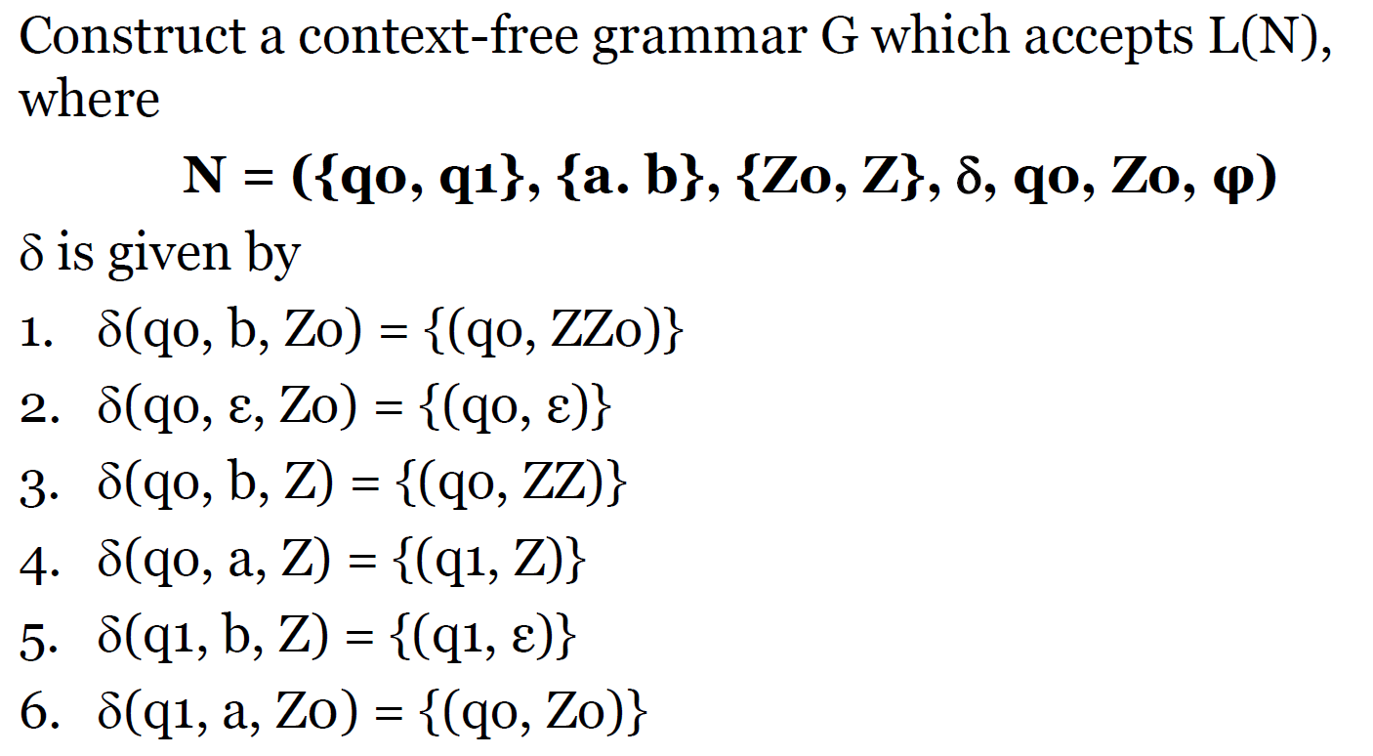

Slide 198
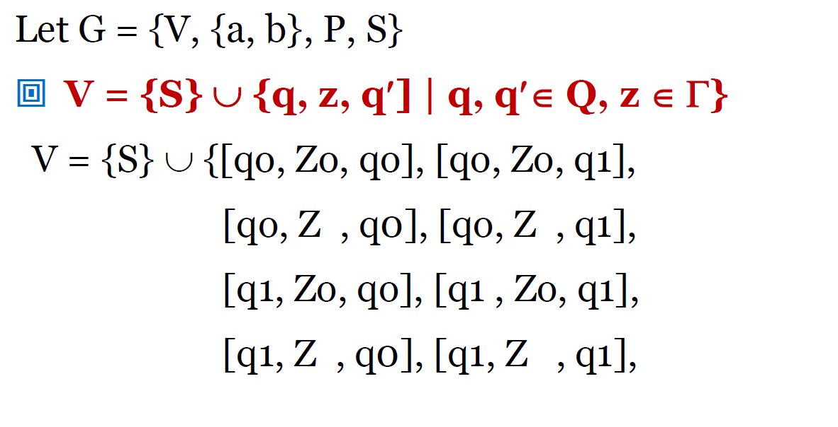

Slide 199
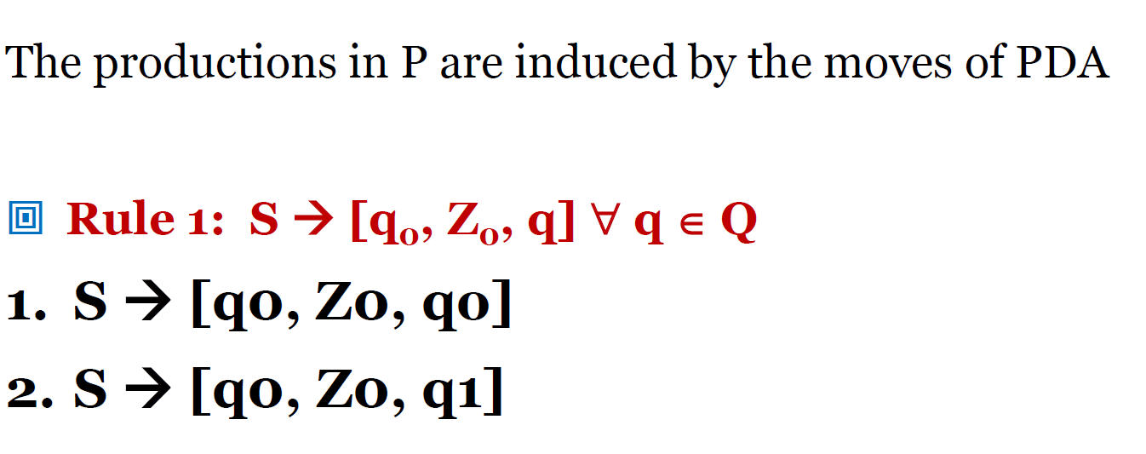

Slide 200
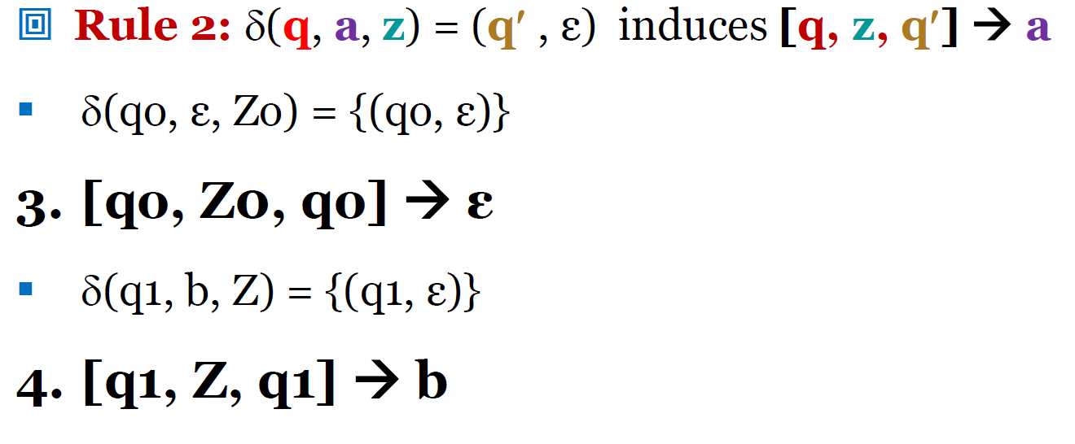

Slide 201


Slide 202


Slide 203


Slide 204


Slide 205


